Slide 1
Classes Inheritance

Slide 2
Class Inheritance
Inheritance allows you to define a new class that incorporates and extends an already declared class.
• You can use an existing class, called the base class, as the basis for a new class, called the derived class. The members of the derived class consist of the following:
– The members in its own declaration
– The members of the base class
• To declare a derived class, you add a class-base specification after the class name. The class-base specification consists of a colon, followed by the name of the class to be used
as the base class. The derived class is said to directly inherit from the base class listed.
• A derived class is said to extend its base class, because it includes the members of the base class plus any additional functionality provided in its own declaration.
• A derived class cannot delete any of the members it has inherited.

Slide 3
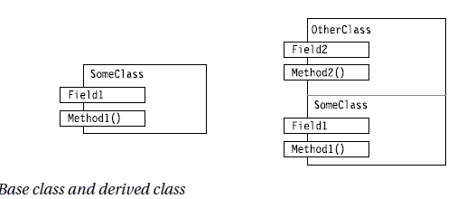
Class-base specification
↓
class OtherClass : SomeClass
{ ↑ ↑
... Colon Base class
}
Figure 7-1 shows an instance of each of the classes. Class SomeClass, on the left, has one
field and one method. Class OtherClass, on the right, is derived from SomeClass and contains an additional field and an additional method.
Figure Base class and derived class

Slide 4
Base Class
A proporties
B proporties
C proporties
Show derivated class
Derivated Class
proporties
proporties
D proporties
Defined in derivated class
A proporties
B proporties
Defined in base class
These proporties reacble from derivated class
C proporties
(inheretance)

Slide 5
Inheritance
Kalıtım ilişkisi genellikle sınıf diyagramında temel sınıfı işaret eden bir ok ile gösterilir.
Kalıtım is-a ilişkisi oluşturmalıdır yani çocuk temel sınıfın daha spesifik sürümü olmalıdır.
Animal
Bird

Slide 6
Temel sınıf ve türetilmiş sınıf örnekleri
Temel sınıf | Türetilmiş sınıf
Ogrenci | MasterOgrenci LisansOgrenci PhdOgrenci
GeoNesne | Daire Ucgen Dikdortgen Kare
Personel | Memur OgretimUyesi Mudur
Bankahesabı | TasarrufHesabı MaasHesabı DovizHesabı

Slide 7
class Otomobil
{
...
}
Base class
Derivated class name
↓
class SporOtomobil : Otomobil
{ ↑ ↑
... Column Base class
}
SporOtomobil class derivated from Otomobil class.
Derivated class

Slide 8
Accessing the Inherited Members
Inherited members are accessed just as if they had been declared in the derived class itself.(Inherited constructors are a bit different—I’ll cover them later in the chapter.) For example, the following code declares classes SomeClass and OtherClass, which were shown in Figure 7-1.
The code shows that all four members of OtherClass can be seamlessly accessed, regardless of whether they are declared in the base class or the derived class.
• Main creates an object of derived class OtherClass.
• The next two lines in Main call Method1 in the base class, using Field1 from the base class, and then Field2 from the derived class.
• The subsequent two lines in Main call Method2 in the derived class, again using Field1 from the base class and then Field2 from the derived class.

Slide 9
class SomeClass
{ // Base class
public string Field1 = "base class field";
public void Method1( string value )
{
Console.WriteLine("Base class -- Method1: {0}", value);
}
}
class OtherClass: SomeClass
{ // Derived class
public string Field2 = "derived class field";
public void Method2( string value )
{
Console.WriteLine("Derived class -- Method2: {0}", value);
}
}
class Program {
static void Main() {
OtherClass oc = new OtherClass();
oc.Method1( oc.Field1 ); // Base method with base field
oc.Method1( oc.Field2 ); // Base method with derived field
oc.Method2( oc.Field1 ); // Derived method with base field
oc.Method2( oc.Field2 ); // Derived method with derived field
}
}

Slide 10
The output of the program
Base class -- Method1: base class field
Base class -- Method1: derived class field
Derived class -- Method2: base class field
Derived class -- Method2: derived class field

Slide 11
using System;
using System.Collections.Generic;
using System.Linq;
using System.Text;
using System.Threading.Tasks;
namespace _01_kalıtım
{
public class anaSınıf
{
public anaSınıf()
{
Console.WriteLine("ana sınıf kurucusu");
}
public void yaz()
{
Console.WriteLine("Ben sınıftayım");
}
}
public class ogulSınıf:anaSınıf
{
public ogulSınıf()
{
Console.WriteLine("Ogul Kurucu");
}
}
class Program
{
static void Main(string[] args)
{
ogulSınıf ogul = new ogulSınıf();
ogul.yaz();
Console.ReadKey();
}
}
}

Slide 12
Polymorphism is often referred to as the third pillar of object-oriented programming, after encapsulation and inheritance. Polymorphism is a Greek word that means "many-shaped" and it has two distinct aspects:
At run time, objects of a derived class may be treated as objects of a base class in places such as method parameters and collections or arrays. When this occurs, the object's declared type is no longer identical to its run-time type.
Base classes may define and implement virtual methods, and derived classes can override them, which means they provide their own definition and implementation. At run-time, when client code calls the method, the CLR looks up the run-time type of the object, and invokes that override of the virtual method. Thus in your source code you can call a method on a base class, and cause a derived class's version of the method to be executed.
Virtual methods enable you to work with groups of related objects in a uniform way. For example, suppose you have a drawing application that enables a user to create various kinds of shapes on a drawing surface. You do not know at compile time which specific types of shapes the user will create. However, the application has to keep track of all the various types of shapes that are created, and it has to update them in response to user mouse actions. You can use polymorphism to solve this problem in two basic steps:
Create a class hierarchy in which each specific shape class derives from a common base class.
Use a virtual method to invoke the appropriate method on any derived class through a single call to the base class method.
First, create a base class called Shape, and derived classes such as Rectangle, Circle, and Triangle. Give the Shape class a virtual method calledDraw, and override it in each derived class to draw the particular shape that the class represents. Create a List<Shape> object and add a Circle, Triangle and Rectangle to it. To update the drawing surface, use a foreach loop to iterate through the list and call the Draw method on each Shapeobject in the list. Even though each object in the list has a declared type of Shape, it is the run-time type (the overridden version of the method in each derived class) that will be invoked.

Slide 13
Polymorphism is often referred to as the third pillar of object-oriented programming, after encapsulation and inheritance. Polymorphism is a Greek word that means "many-shaped" and it has two distinct aspects:
At run time, objects of a derived class may be treated as objects of a base class in places such as method parameters and collections or arrays. When this occurs, the object's declared type is no longer identical to its run-time type.
Base classes may define and implement virtual methods, and derived classes can override them, which means they provide their own definition and implementation. At run-time, when client code calls the method, the CLR looks up the run-time type of the object, and invokes that override of the virtual method. Thus in your source code you can call a method on a base class, and cause a derived class's version of the method to be executed.
Virtual methods enable you to work with groups of related objects in a uniform way.

Slide 14
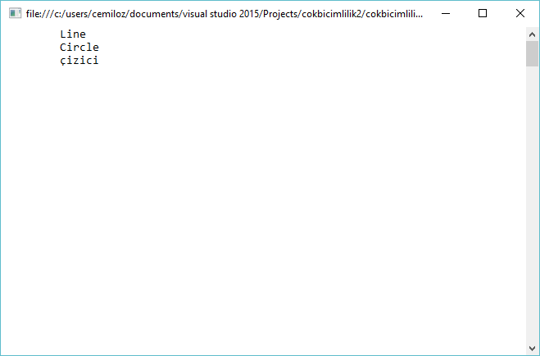
using System;
using System.Collections.Generic;
using System.Linq;
using System.Text;
using System.Threading.Tasks;
public class Çizici
{
public virtual void Çiz() //temel sınıf metodu
{ //(türetilen sınıflarda değiştirilebilir.)
Console.WriteLine("\t çizici");
}
}
public class DoğruÇiz : Çizici
{
public override void Çiz() // türetilen sınıf Çiz metodu
{
Console.WriteLine("\t Line");
}
}
public class DaireÇiz : Çizici
{
public override void Çiz() // türetilen sınıf Çiz metodu
{
Console.WriteLine("\t Circle");
}
}
public class Program
{
static void Main(string[] args)
{
Çizici[] birÇizici = new Çizici[3];
birÇizici[0] = new DoğruÇiz(); // türetilen sınıf nesnesi
birÇizici[1] = new DaireÇiz(); // türetilen sınıf nesnesi
birÇizici[2] = new Çizici(); // temel sınıf nesnesi
foreach (Çizici sayac in birÇizici)
{
sayac.Çiz(); // çok biçimli çağrısı
}
Console.ReadLine();
}
}

Slide 15
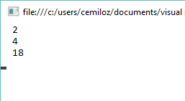
using System;
using System.Collections.Generic;
using System.Linq;
using System.Text;
using System.Threading.Tasks;
public abstract class Vehicle
{
public virtual int Wheels()
{
return 0;
}
}
public class Bicycle : Vehicle
{
public override int Wheels()
{
return 2;
}
}
public class Car : Vehicle
{
public override int Wheels()
{
return 4;
}
}
public class Truck : Vehicle
{
public override int Wheels()
{
return 18;
}
}
public class program
{
static void Main(string[] args)
{
Vehicle[] a = new Vehicle[3];
a[0] = new Bicycle();
a[1] = new Car();
a[2] = new Truck();
foreach (Vehicle sayac in a)
{
Console.WriteLine(" {0}", sayac.Wheels()); // çok biçimli çağrısı
}
Console.ReadLine();
}
}

Slide 16
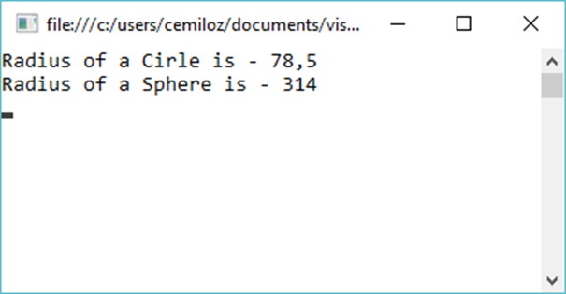
using System;
using System.Collections.Generic;
using System.Linq;
using System.Text;
using System.Threading.Tasks;
namespace ConsoleApplication3
{
public class clsShape
{
public int _radius = 5;
public virtual double getArea()
{
return 0;
}
}
public class clsCircle : clsShape
{
public override double getArea()
{
return 3.14 * _radius * _radius;
}
}
public class clsSphere : clsShape
{
public override double getArea()
{
return 4 * 3.14 * _radius * _radius;
}
}
class Program
{
static void Main(string[] args)
{
clsShape objShape1 = new clsCircle();
clsShape objShape2 = new clsSphere();
Console.WriteLine("Radius of a Cirle is - {0}", objShape1.getArea());
Console.WriteLine("Radius of a Sphere is - {0}", objShape2.getArea());
Console.ReadKey();
}
}
}

Slide 17
using System;
using System.Collections.Generic;
using System.Linq;
using System.Text;
using System.Threading.Tasks;
class Arac
{
public void Calistir(string ses)
{
Console.WriteLine("Araç çalıştırılıyor: {0}", ses);
}
public void MotoruKapat(string ses)
{
Console.WriteLine("Araç motoru kapatılıyor: {0}", ses);
}
public virtual void Sur()
{
Console.WriteLine("Araç Sürülüyor");
}
}
class Araba : Arac
{
public void Hizlan()
{
Console.WriteLine("Araba Hızlanıyor");
}
public void FrenYap()
{
Console.WriteLine("Araba Fren Yapıyor");
}
public override void Sur()
{
Console.WriteLine("Araba Sürülüyor");
}
}

